Slide 1

Lecture 4 Variable types & constructors

Slide 2
‘This’
‘This can be used inside any method to refer to the current object
works as a reference to the current Object whose Method or constructor is being invoked

Slide 3
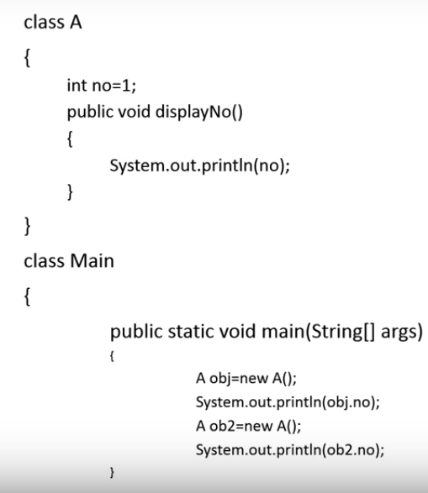
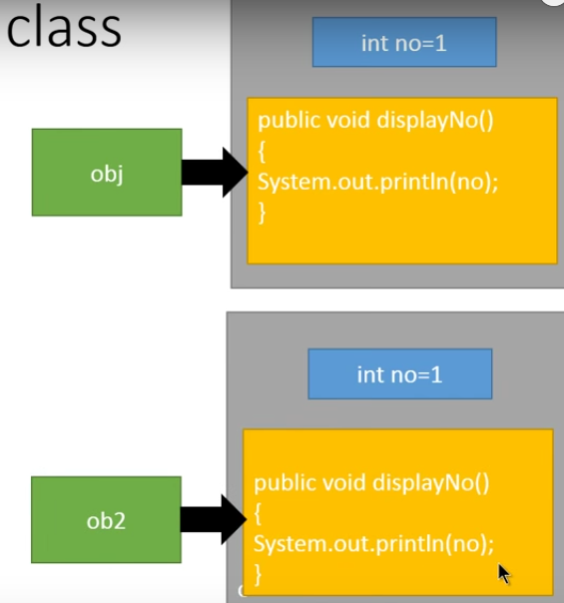

Slide 4
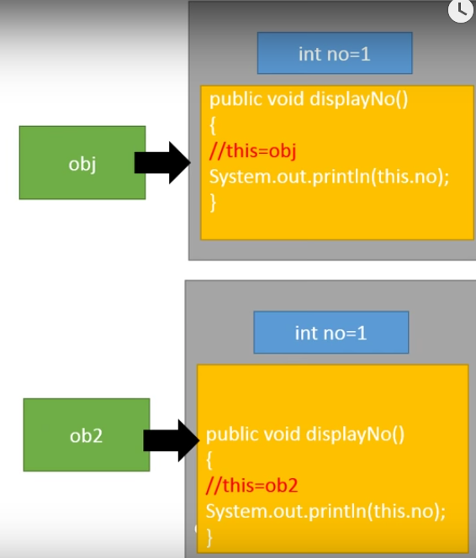
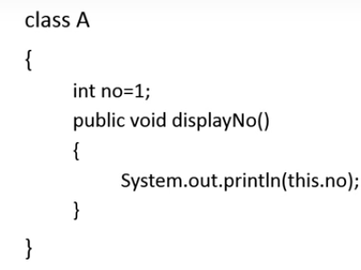

Slide 5
Instance variable hiding
When a local variable has the same name as instance variable the local variable hides the instance variable

Slide 6
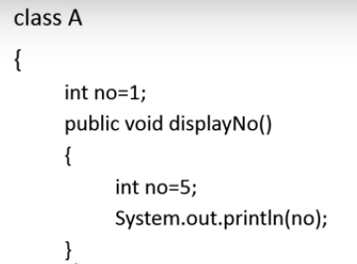

Slide 7
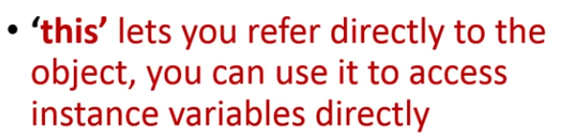
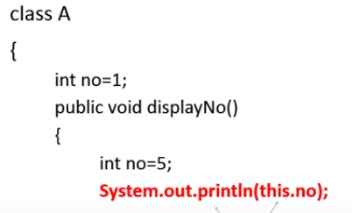

Slide 8
Static Variable
The static keyword in Java means that the variable or function is shared between all instances of that class
only a single instance of the associated variable is created, which is common to all the Objects of that Class
when one Object changes the value of a Class variable, it affects all the Objects of the Class.

Slide 9
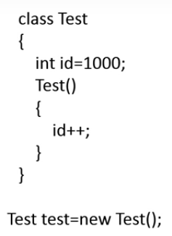
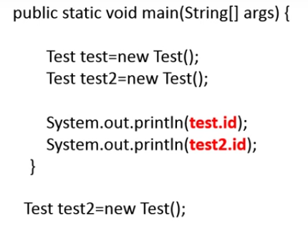
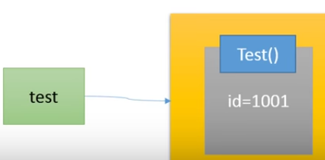
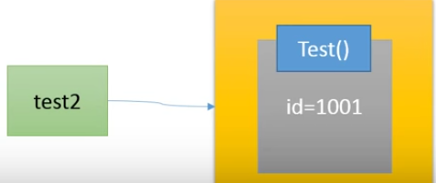

Slide 10
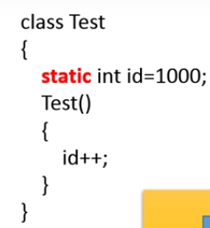
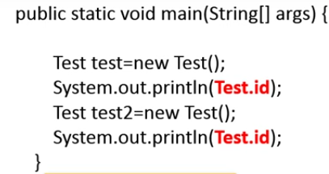






Slide 11
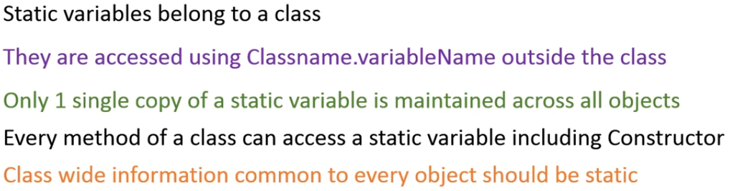
Static Variable

Slide 12
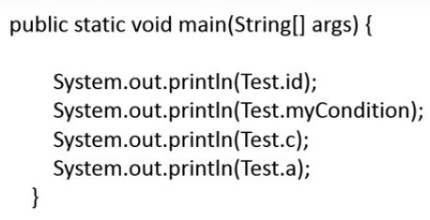
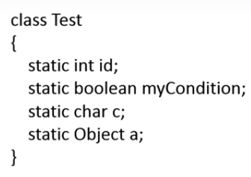
Static Variable

Slide 13
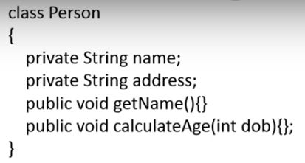
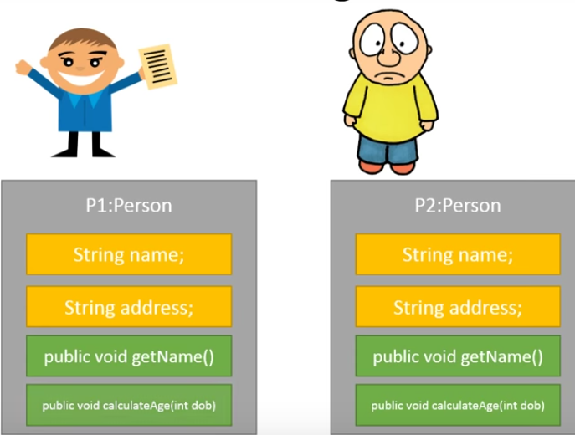
Static Method

Slide 14
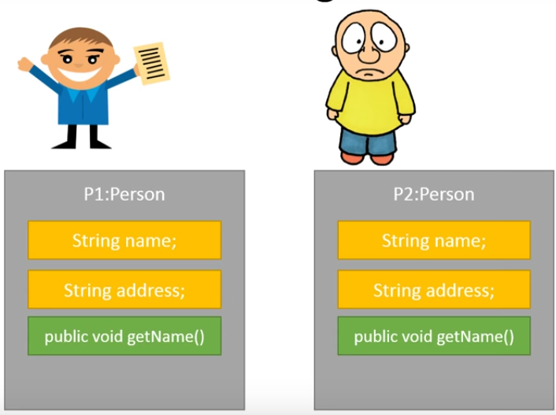


Slide 15
Static Method
A static method belongs to the class rather than object of a class.
A static method can be invoked without the need for creating an instance of a class.

Slide 16
final
final keyword is used to define an entity that can only be assigned once.
Once a final variable has been assigned, it always contains the same value.
Final variables are safe to share in multi-threading environment without additional synchronization overhead.

